Slide 1
Order Planner ekanban setup
L2L 2021

Slide 2
1. Items to setup before ekanban use
10 Simple Steps
Resource Shifts are Setup and not overlapping
Enable Production features (ekanban functionality) in line settings
Set up Product Order settings in production setup menu
Create / Setup production load templates
Setup the products in the production module
Setup line cycle times by product
Add Product orders to line schedule
Load shift schedule to the lines
Schedule orders to the production line
Ready to start using in the portal
Note: The Order Planner needs to be turned on in a site (Get with L2L if needed)

Slide 3
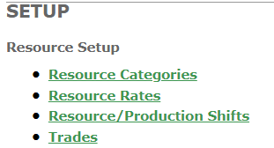
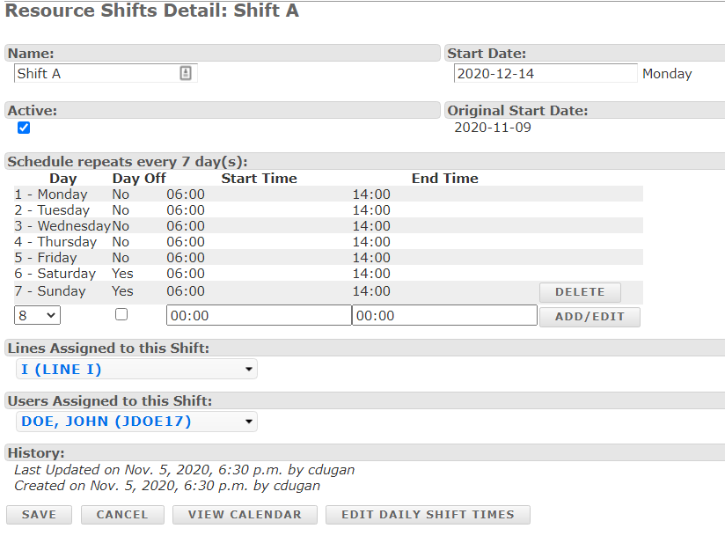
1. Resource Shift Setup
Note: Make sure the shift times do not overlap for the production line

Slide 4
2. Setup Needed in line settings for each line
Setup line screen (Admin access only)
1
2
3
Line setup needs to be added to enable eKanban system
Shifts and Default Pitch Templates Needed (Both of these can be set in the settings for shifts and templates)
Select save at the bottom of the page

Slide 5
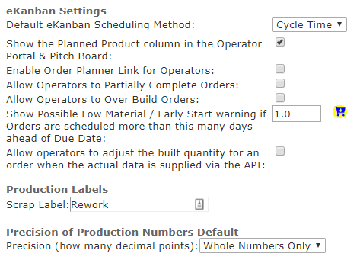
3. Production settings for ekanban

Slide 6
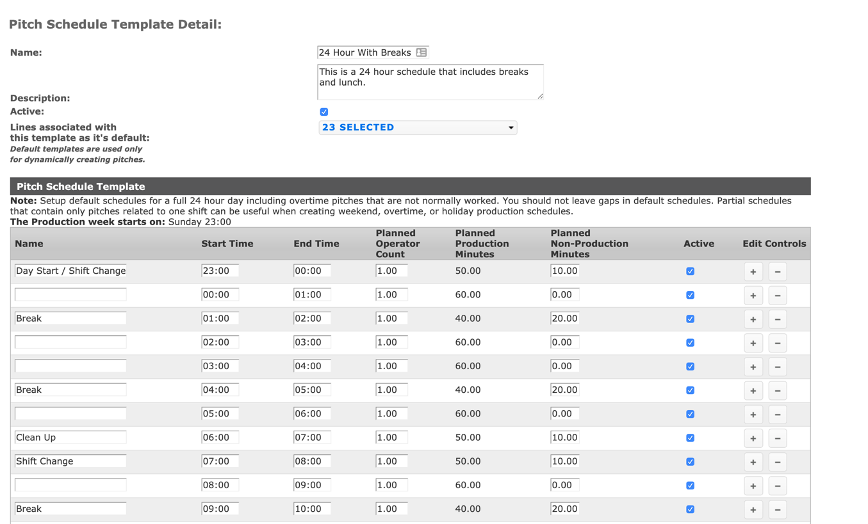
4. Create a Pitch Schedule Template
Label the individual pitches with milestones during the schedule
Add a start and end time to the first pitch in the sequence. L2L will auto populate the new times from here on out
If not using Op Portal check in. Select a default Operator Count per pitch
Determine Non-Prod minutes per pitch. Planned Prod minutes will auto change.
Select plus (+) to add the next pitch
When complete, Save the template and then choose associated lines
* Associated lines will be added after the Template is saved
*
1
2
3
4
5

Slide 7
5. Load products into L2L system in the production module under products.
You can color code the products to make them more visible in the portal
Note: This may already be setup from your MES traceability system into L2L

Slide 8
6. Add the line cycle times by product in the production tab. Be sure to add the operator count along with the cycle times that could run the line along with each product that can run on the line. (see example below) This is used for OEE and also for scheduling the line with orders.(demand)
Note: In Example to the left they setup the amount of operators and cycle time that could run on the line. (1-4)

Slide 9
6.1 Production Planning and OEE Percentage
Planning rate - anything less than 100% means the system will schedule the line at the cycle time in second by the planning rate percentage.
Cycle time for OEE Calculation
Cycle time for Production Planning
If no operator count is set in the schedule, the system will pick the first one. In above example 19.5 will be the plan cycle time for this product

Slide 10
7.0 Product Order loading (Options to choose )
Manual Entry
Enter product orders in L2L for planning then schedules those to be built.
Integration from ERP or Planning Software to L2L (API’s)
Send orders through integration programming to L2L (programing needed)
This may require to also connect to your current integrations from your traceability system.
Upload Excel Template of Planning (Most Popular)
Upload from an excel provided template through a planned feature in L2L

Slide 11
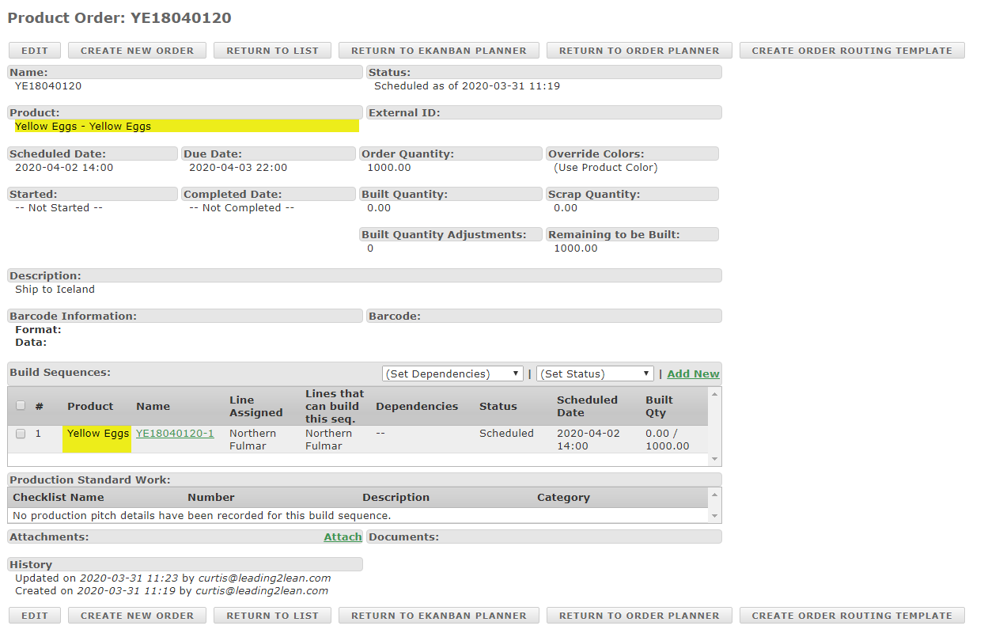
7. 1 Manual Entry of Product Orders

Slide 12
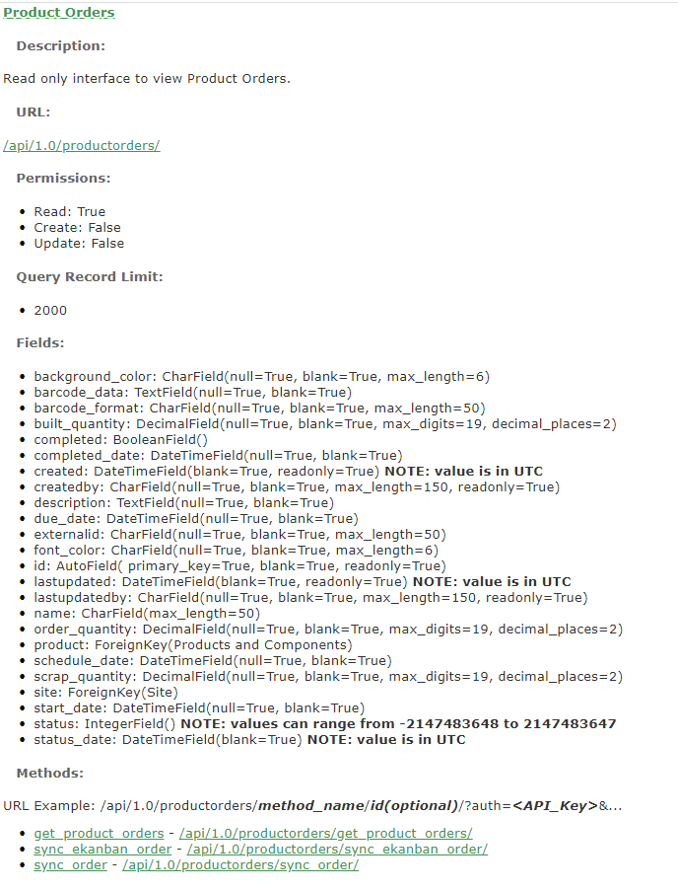
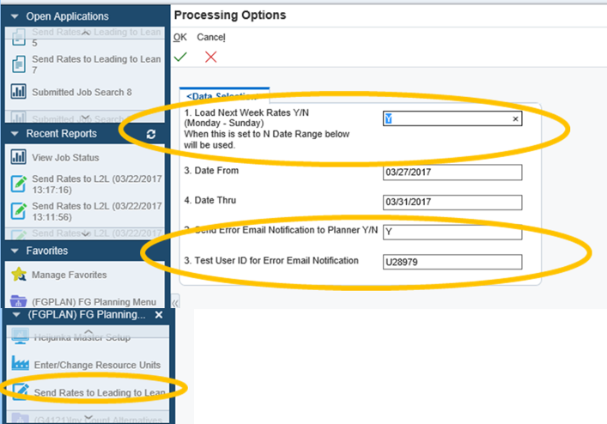
7.2 API load from ERP
Example of ERP Planner tool

Slide 13
7.3 Load the excel template with your orders
Load Red columns (mandatory) at a minimum in the excel spreadsheet template with your orders and save file to a location you can find.
Product code: Can be product identifier
Name: Can be ship to location as column C&D show on operator portal
Status: Put planning in this column to load orders into eKanban planner
Schedule date: the day or start of week you want the orders to load
Due Date: The date you want the orders to be completed by.
Order Quantity: How many of that order is needed that day or week
Card Size: This is used by many as the standard pack size for that product.
Line Code: This is the exact name of the line in L2L (look at code in Line setup)
Note the date and time format

Slide 14
7.3.1 Upload template import tool in L2L
3
4
1
Open Production tab
Click on production imports
Click browse and load your excel template file
Click next step
2

Slide 15
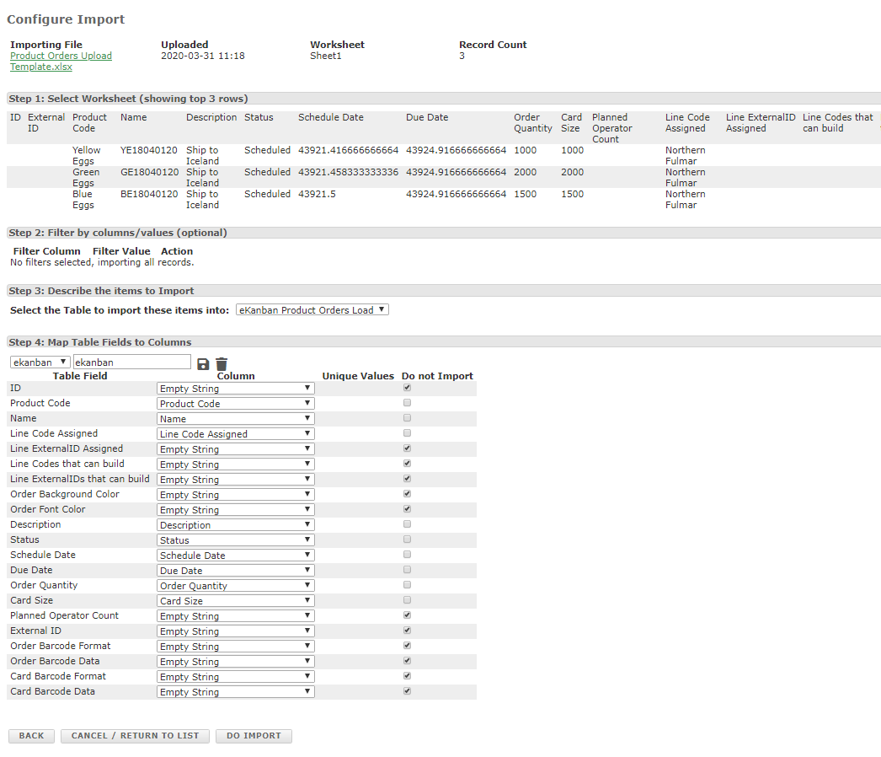
7.3.2 Load excel template in the L2L import tool
1
2
Review your data to make sure it imported ok
it will show the first 3 lines in your template
You can only have one header row
Skip step 2 and go to step 3 and select eKanban Product Orders Load

Slide 16
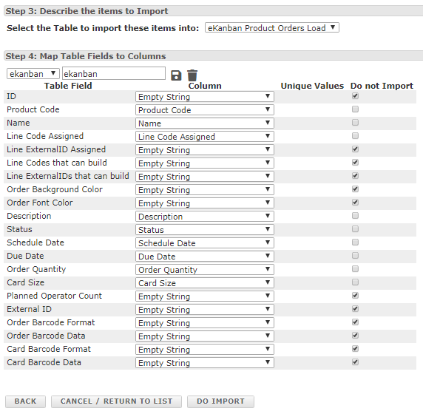
7.3.3 Do the Import
Make sure all import table fields match
Note: The do import button will be missing if any one of the fields are not matched
Click the Do Import button to load
Click ok (pop up after Do import is selected)
Note: the import can take a few minutes, look for the import results at bottom of page
Make sure you confirm the site before clicking ok
1
3
2

Slide 17
8. Schedule a Line
Before proceeding, ensure that all settings are properly turned on for individual lines in Setup menu (step 2)
Shortcut to view the Template
Shortcut to create a Template
1
2
4
3
Choose the ‘Area’ the line you wish to schedule belongs to
Select a Line you wish to schedule (Note: You will be able to select multiple lines in subsequent steps)
Select the shifts to be used in this schedule. (Note: Unless a special instances, Show All Shifts in generally used)
Select the Template you wish to use. (Note: If the template does not show on the drop-down, then you may need to associate the line with the required template)
Select ‘Load’

Slide 18
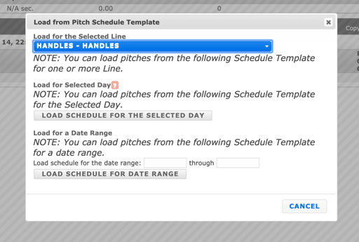
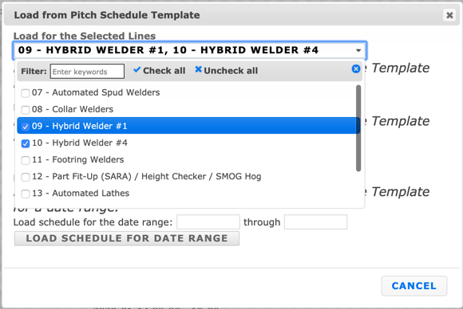
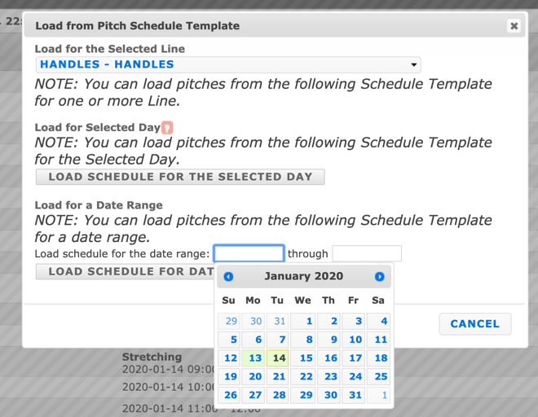
8.1 Load The Pitch Schedules (Multiple Line and Multiple Days)
Choose multiple lines here if desired
Schedule for the day or a date range

Slide 19
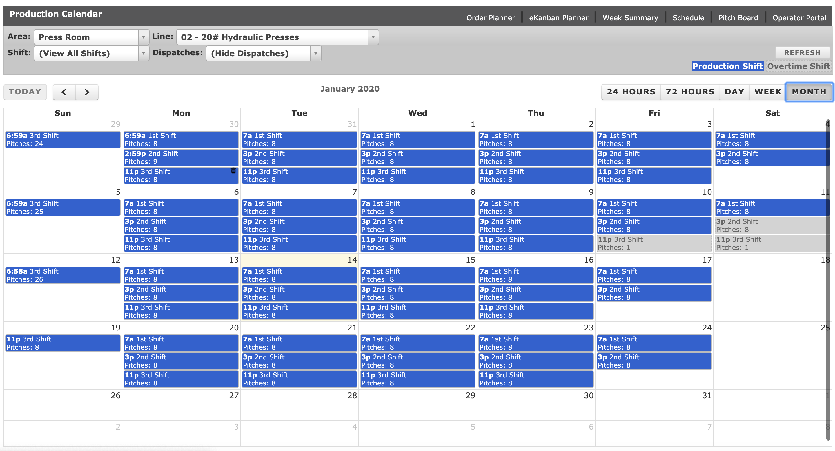
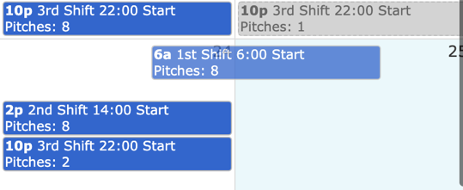
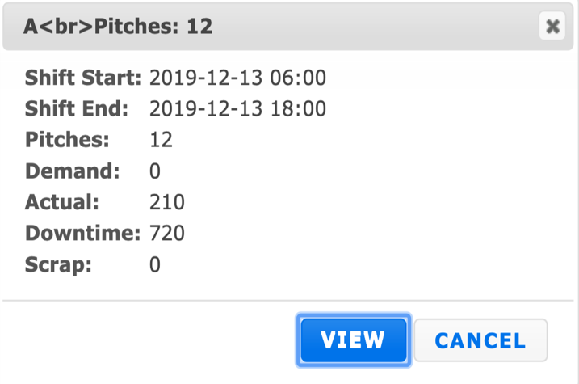
8.2 Using The Calendar
Drag & Drop
Schedules

Slide 20
9.0 eKanban planner screen for the line
1
2
4
3
Note: Products will not load if cycle times have not been setup for the production line
Set the Area and line you want to schedule
Set the status to planning and the QTY to filter by quantity
Set ‘schedule start date’ and ‘due date’ end date
Select refresh. (Anytime you make a change to the top of this screen you must select refresh to see the changes.)

Slide 21
9.1 How to level load the orders to portal
1
2
3
4
Select the dates you want to load from the above planning
Select quantity or cycle time to load the orders and verify your quantity
Select level loading type. (group by due date will load by that date in your planning
Select the change over type you want to load (this will set the schedule)
Note: group by due date and minimal changeovers will schedule the orders by the due date you set in the upload template

Slide 22
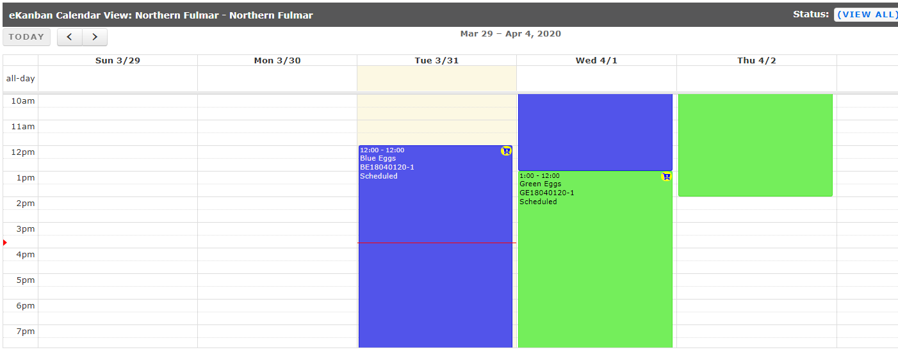
9.3 Lines are now scheduled (example)
eKanban Planner Screen View
Order Planner Screen View

Slide 23
10. Ready to start order

